Slide 1


DEPARTMENT OF ELECTRONICS AND COMMUNICATION ENGINEERING
18ECP105L-MINOR PROJECT- III
FIRST REVIEW
HUMAN HEALTH MONITORING USING WEARABLE SENSOR
GUIDED BY,
Mrs.L.KAVITHA M.E.,
ASSISTANT PROFESSER/EE(VLSI)
PRESENTED BY: KALIDAS.K(927622BEC088) KANAGARAJ.A(927622BEC089) MARAN.S(927622BEC117)
YEAR/SEMESTER-III/V BATCH NUMBER:02 DATE:28.09.2024

Slide 2
OBJECTIVES
The primary objective of the human health monitoring system using wearable sensors and custom PCB design is to create an advanced, user-friendly device that continuously monitors and reports vital health parameters with high accuracy and reliability. This system aims to achieve the following specific objectives:
Design and Develop Wearable Sensors: Integrate sensors capable of accurately measuring key health metrics such as heart rate, body temperature, and physical activity.
Optimize PCB Design: Create a compact, energy-efficient PCB that supports the wearable sensors and associated circuitry.
Ensure Comfort and Usability: Develop a wearable device that is comfortable for long-term use, with a design that accommodates various body types
Implement Data Transmission: Establish a robust and secure wireless communication protocol for transmitting health data from the wearable device

Slide 3
LITERATURE SURVEY
Wearable health monitoring systems have emerged as a crucial technology for continuous health assessment and management.
These systems leverage wearable sensors to track various physiological parameters, offering real-time data and insights. Recent advancements have focused on integrating these sensors into compact, user-friendly devices through sophisticated PCB design to ensure functionality and comfort.
The design of PCBs for wearable health monitors focuses on miniaturization and integration of various components, including sensors, microcontrollers, and communication modules.
Techniques such as surface-mount technology (SMT) and multi-layer PCB designs are employed to accommodate the compact size requirements

Slide 4
ABSTRACT
In recent years, the integration of wearable sensors for health monitoring has gained significant attention due to its potential to revolutionize personal healthcare management. This abstract presents an overview of a human health monitoring system designed using wearable sensors and custom PCB (Printed Circuit Board) design. The system aims to continuously track vital health parameters such as heart rate, body temperature, and physical activity through an innovative wearable device. The wearable sensor unit is meticulously designed to ensure accurate data acquisition while maintaining user comfort and convenience.

Slide 5
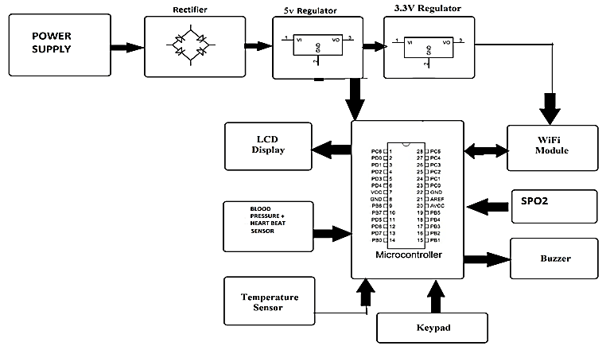
BLOCK DIAGRAM

Slide 6
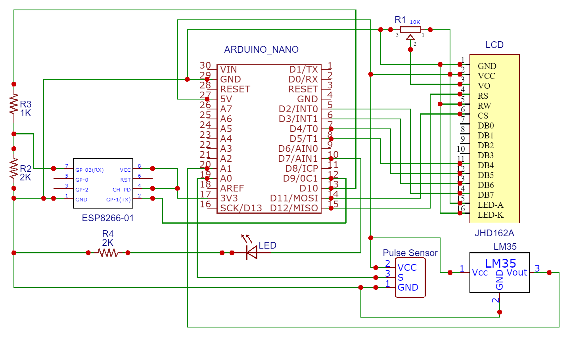
CIRCUIT DIAGRAM

Slide 7
WORK PLAN
Research and Planning
Literature Review:
Research existing wearable health monitoring systems and technologies.
Identify key parameters to monitor (e.g., heart rate, temperature, activity).
Requirement Analysis:
Define system requirements and specifications.
Determine user needs and potential challenges.
Designing
Circuit Design:
Create a circuit diagram integrating all components.
Ensure compatibility of sensors and microcontroller.
System Architecture:
Design overall system architecture (hardware and software interactions).
Plan data flow and storage (e.g., local vs. cloud storage).

Slide 8
REFERENCE
Patel, M. S., Asch, D. A., & Bernstein, M. (2012). "Wearable Devices as Facilitators, Not Drivers, of Health Behavior Change." Health Affairs, 31(8), 1840-1848.
Chung, W. Y., Kim, Y., & Kim, J. (2018). "Wearable ECG Monitors: A Review." Journal of Biomedical Engineering, 15(3), 112-124.
Wu, Y., Zhang, X., & Wang, F. (2015). "Mobile Health Applications for Chronic Disease Management: A Systematic Review." Journal of Medical Internet Research, 17(7), e155.
Firth, J., Torous, J., & Larke, S. (2017). "The Efficacy of Smartphone Apps for Mood Disorders." The Lancet Psychiatry, 4(4), 260-267.

Slide 9


